Slide 1
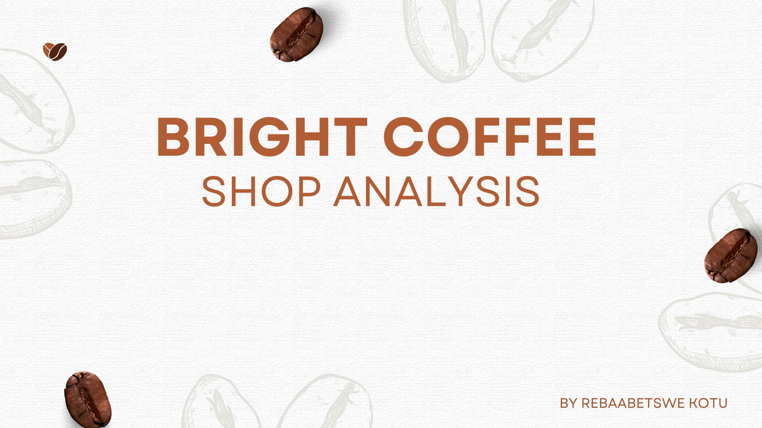


Slide 2

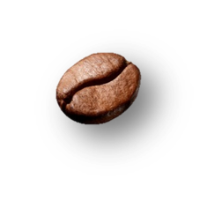
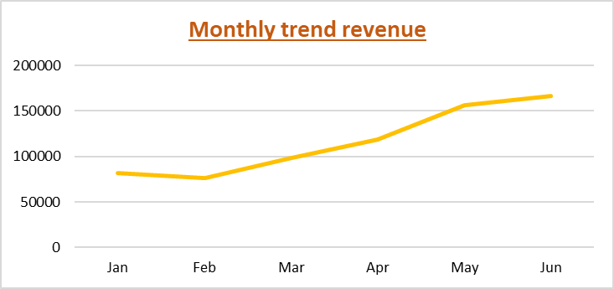
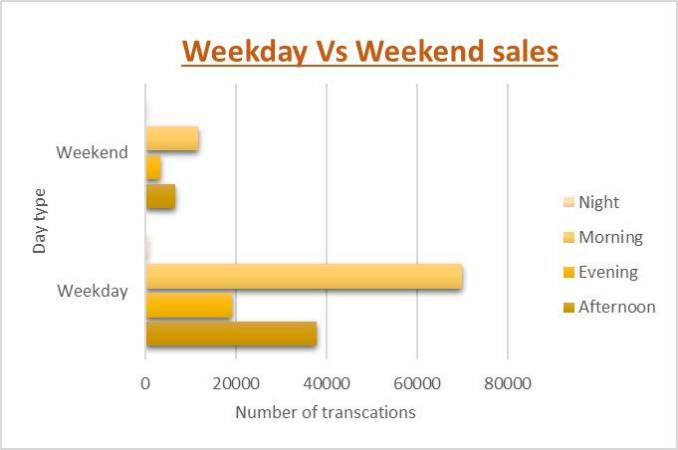
Sales trends
Revenue grew steadily throughout the year.
Peaked in winter, this suggest a strong Autumn and Winter season impact.
This period can be used for seasonal promotions.
Weekday sales outperform weekend sales.
This suggests that most of our customers work around the store location areas
Loyalty campaigns must be considered for weekdays customers.

Slide 3
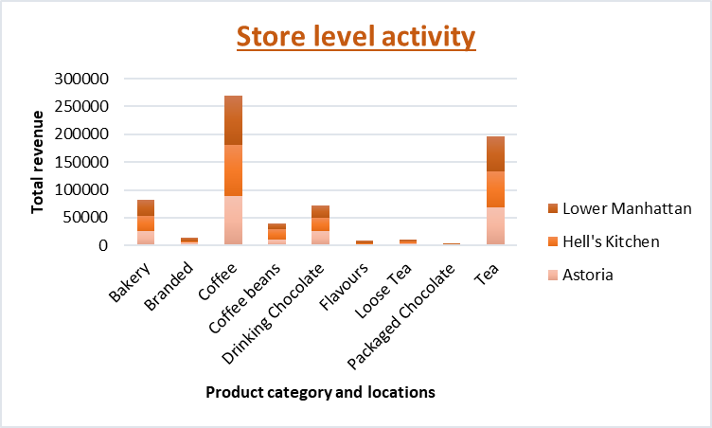
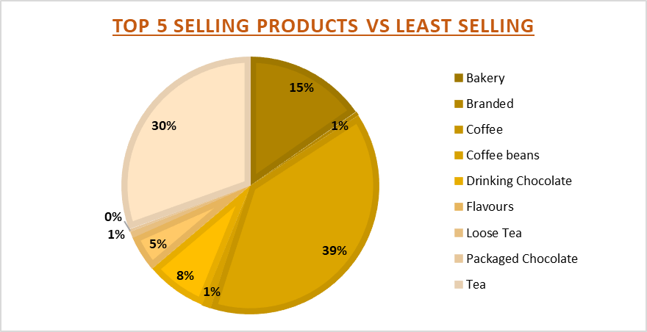
Product analysis
Coffee and tea are customers favourites in all locations.
High activity seen in Lower Manhattan, followed by Hell’s Kitchen.
Campaigns on low selling products could boost revenue.
Coffee and tea are our customers favourites.
With coffee contributing 39% followed by tea with 30%.
Least selling products may require re-evaluation.

Slide 4

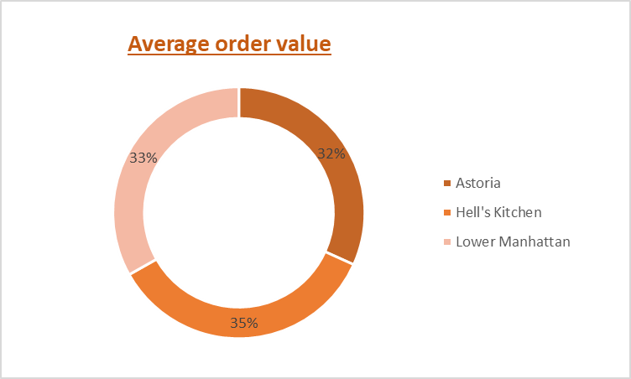
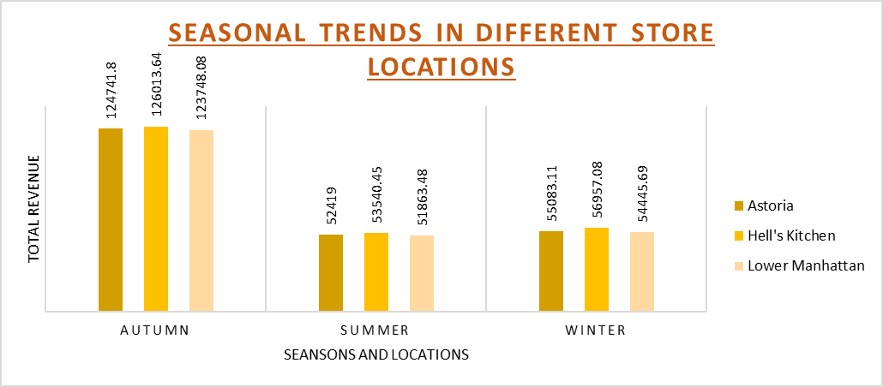
Store location analysis
Autumn records the highest sales across all three stores.
Followed by Winter then Summer.
Sales remain evenly distributed across all stores regardless of location.
This is indicative of stability in terms of demand.
Hell’s Kitchen has the highest average order value at 35%.
Followed by Lower Manhattan at 33% then Astoria at 32%.
Despite the variation, there is consistency with a near-even distribution.

Slide 5

Recommendations
Boost Average order value
Promote premium or seasonal drinks, especially in Astoria where AOV is low.
Introduce combo offers, this way more products will be sold
Leverage Seasonal trends
With Autumn and winter showing the highest sales, ensure popular items are always in stock.
Promote hot beverages and other preferred items during this period.
Improve performance of low selling products
Offer tasting on products.
Increase their visibility in the stores.
Consider discontinuing items.
Increase weekday traffic
Offer rewards and loyalty points to encourage visits.
Consider a special for the early birds.

Slide 6

Conclusion
The sales data reveals consistent performance across all stores. However, there are measures that can be put in place to better and optimise operations. Campaigns, loyalty points and promotions may assist with attracting more customers. By understanding time and location-based trends we can adjust the inventory to better suit our customers therefore increasing sales.

Slide 7
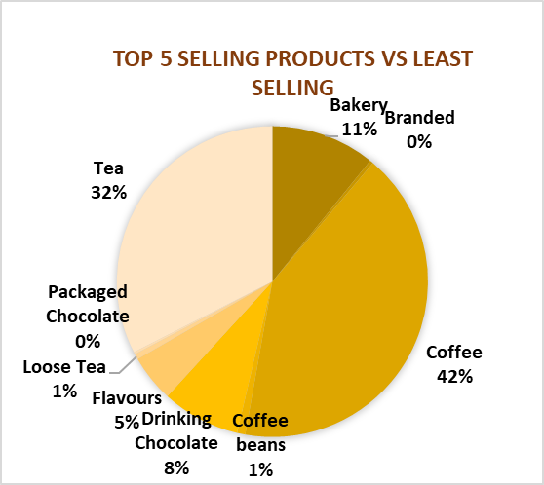
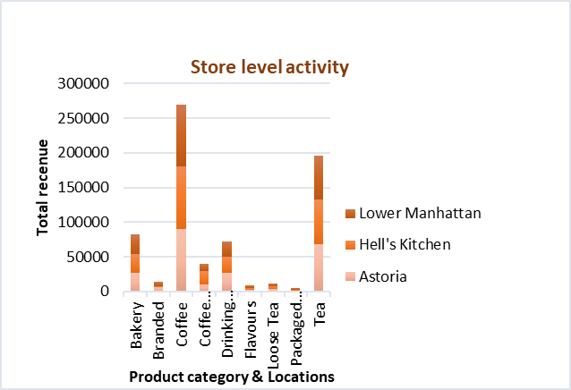
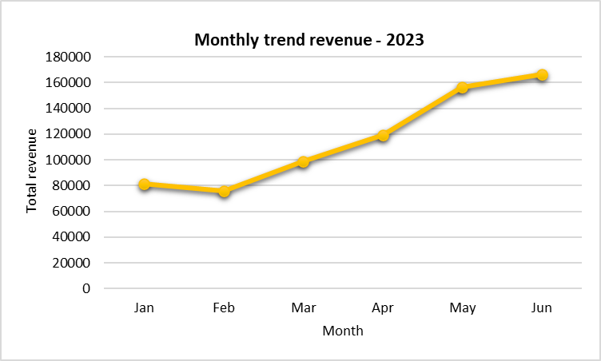


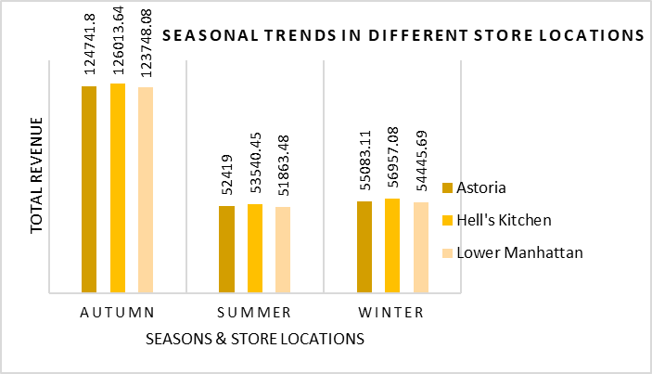
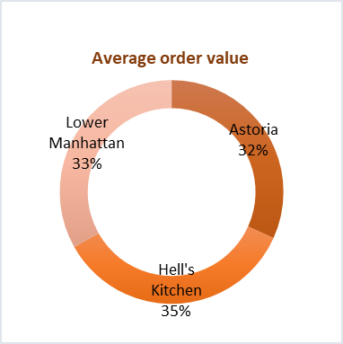
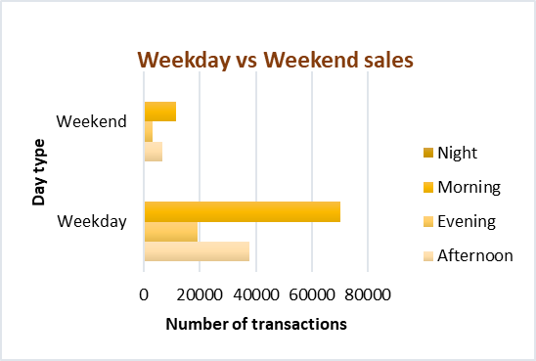
Bright coffee shop analysis
Coffee and tea dominate sales, both accounting for majority of product revenue. Promotional sales must be considered for least selling products.
Steady revenue growth throughout the year, with peaks seen in June. This suggests a strong winter season impact.
Coffee and tea are customers favourites in all locations. High activity seen in Lower Manhattan, followed by Hell’s Kitchen Campaigns on low selling products could boost revenue.
Highest sales seen mornings of weekdays. Consider loyalty campaigns. Less activity seen on weekends, less staff required.
Highest sales in Autumn across all stores. Sales are evenly distributed in Summer and Winter. Demands are stable in all locations.
Consistency seen across all stores with a near even distribution of AOV.

